Slide 1
Combined Meeting of the Project Commission (PC) and Council of Cooperation Partners (CCP)

Slide 2
We will take pictures at the event to use it for the SAVE webpage, e-News and other SAVE publications. Do you agree to be on the picture? If not, please tell it so we can make your face invisible.

Slide 3
Agenda
only PC and CCP are allowed to vote
day’s chairperson and a secretary for the Minutes of the meeting
Project reports and information
Consultings/ EU actions
IMAGE
Dynaversity
GenResBridge
Other projects and actions
Fundus Agri-Cultura Alpina
Collection of wild fruits of Europe (The delicate savages)
Proposals in preparation
EU General Data Protection Regulation (GDPR)
Disease Management and Protection for Endangered Breeds of Farm Animals
Applications to the Board of Directors
next meeting: Belgium 2019?? Other suggestions??
Any other business

Slide 4
SAVE Project Office Project Reports CCP/PC Project reports and information

Slide 5
Consultings / EU Actions
IMAGE (Innovative Management of Animal GEnetic resources); www.imageh2020.eu

Slide 6
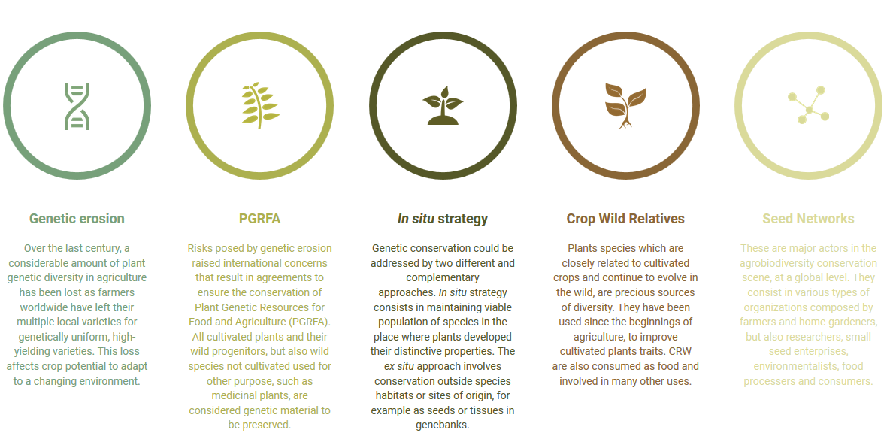
Consultings / EU Actions
Dynaversity; http://dynaversity.eu/

Slide 7
Consultings / EU Actions
GenResBridge (application waiting for acceptance)
Eklipse: http://www.eklipse-mechanism.eu/cap_activities Peer Review

Slide 8
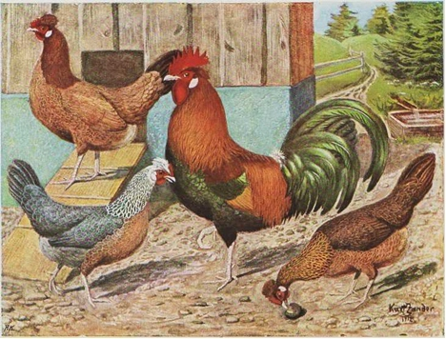
Other projects and actions
Workshop on Chicken , Leipzig, DE, Dec. 2017

Slide 9
Other projects and actions
Fundus Agri-Cultura Alpina first phase finalized

Slide 10
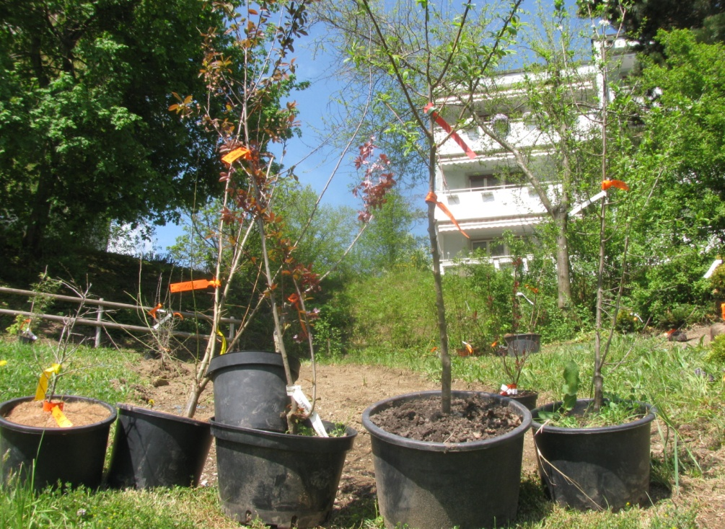
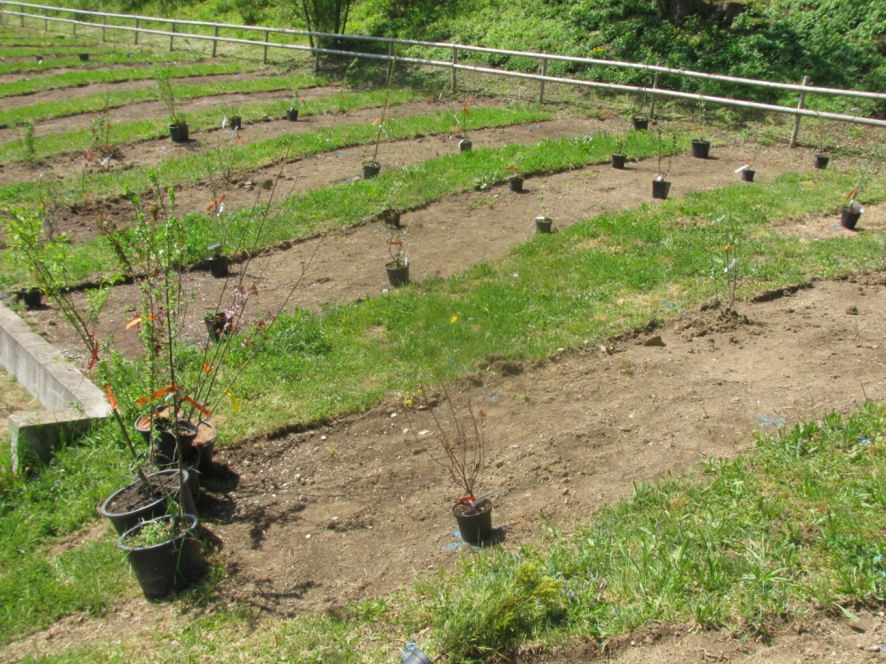
Other projects and actions
Collection of wild fruits of Europe (The delicate savages) started

Slide 11
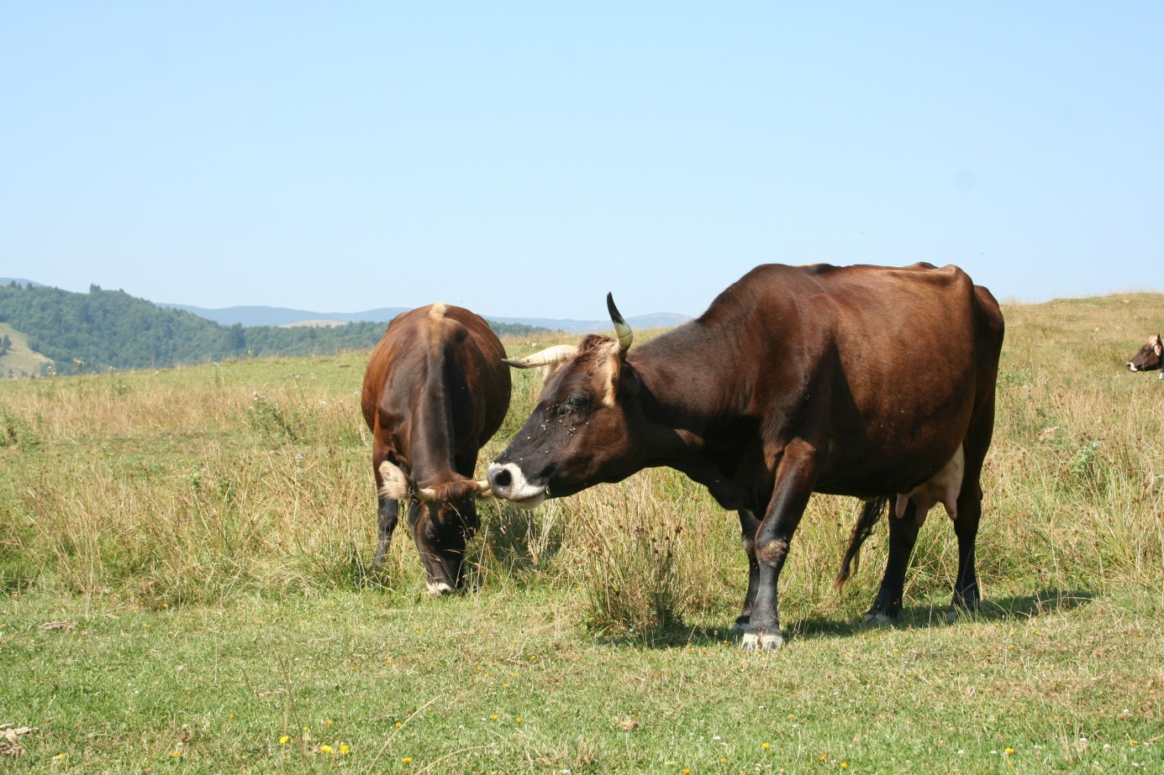
Other projects and actions
Fundraising for proposal on
Mocanitza Cattle, Romania / Moldova / Ukraine

Slide 12
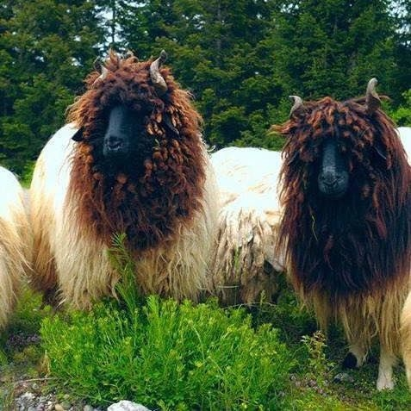
Other projects and actions
Fundraising for proposal on
Balusha sheep, Kosovo

Slide 13
Other projects and actions
Fundraising for proposal on
Aegean Island Conservation Project

Slide 14
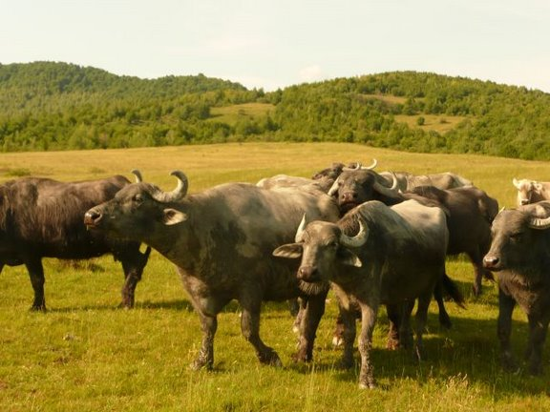
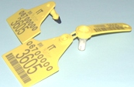
Other projects and actions
Latest News: European Buffaloes – Genetic investigation planned
European network for an investigation of the genetic diversity of water buffaloes

Slide 15
EU General Data Protection Regulation (GDPR)
the most important change in data privacy regulation in 20 years

Slide 16
Webinformation: https://www.eugdpr.org/
Since May 2018
Affects organisations within and outside EU
Conditions for consent need to be clear also within the work of NGOs
Examples: SAVE privacy note: www.save-foundation.net/images/Downloads/SAVE_Privacy_Note_EN.pdf; Disclaimer for events; subscriber confirmation

Slide 17
Data Protection Disclaimer
Your identification information (prefix, first name, last name) will be used to arrange the logistics for this event. Your contact details (e-mail address, cc e-mail, mobile phone number) will be used to contact you regarding your attendance to the meeting and any other practical information related to this event.
Professional data will be shared with other participants on the participants list.

Slide 18
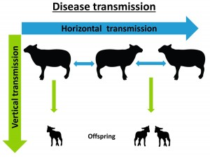
Disease Management and Protection for Endangered Breeds of Farm Animals

Slide 19
Applications to the Board of Directors
next meeting: Belgium 2019?? Other suggestions??
Any other business

Slide 20
Thank you very much for your collaboration

